Slide 1

Web technologies using java
Course 5 – REST webservices

Slide 2
agenda
webservices
Rest webservices
Rest apis
Resources
Representations
http methods and response codes
Rest api design

Slide 3

webservices
Web service: a web server programmed with specific, often reusable, logic
Types of web services:
REST (Representational State Transfer)
SOAP (Simple Object Access Protocol)

Slide 4
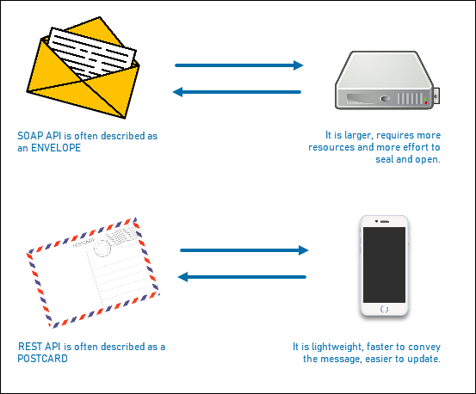
webservices

Slide 5
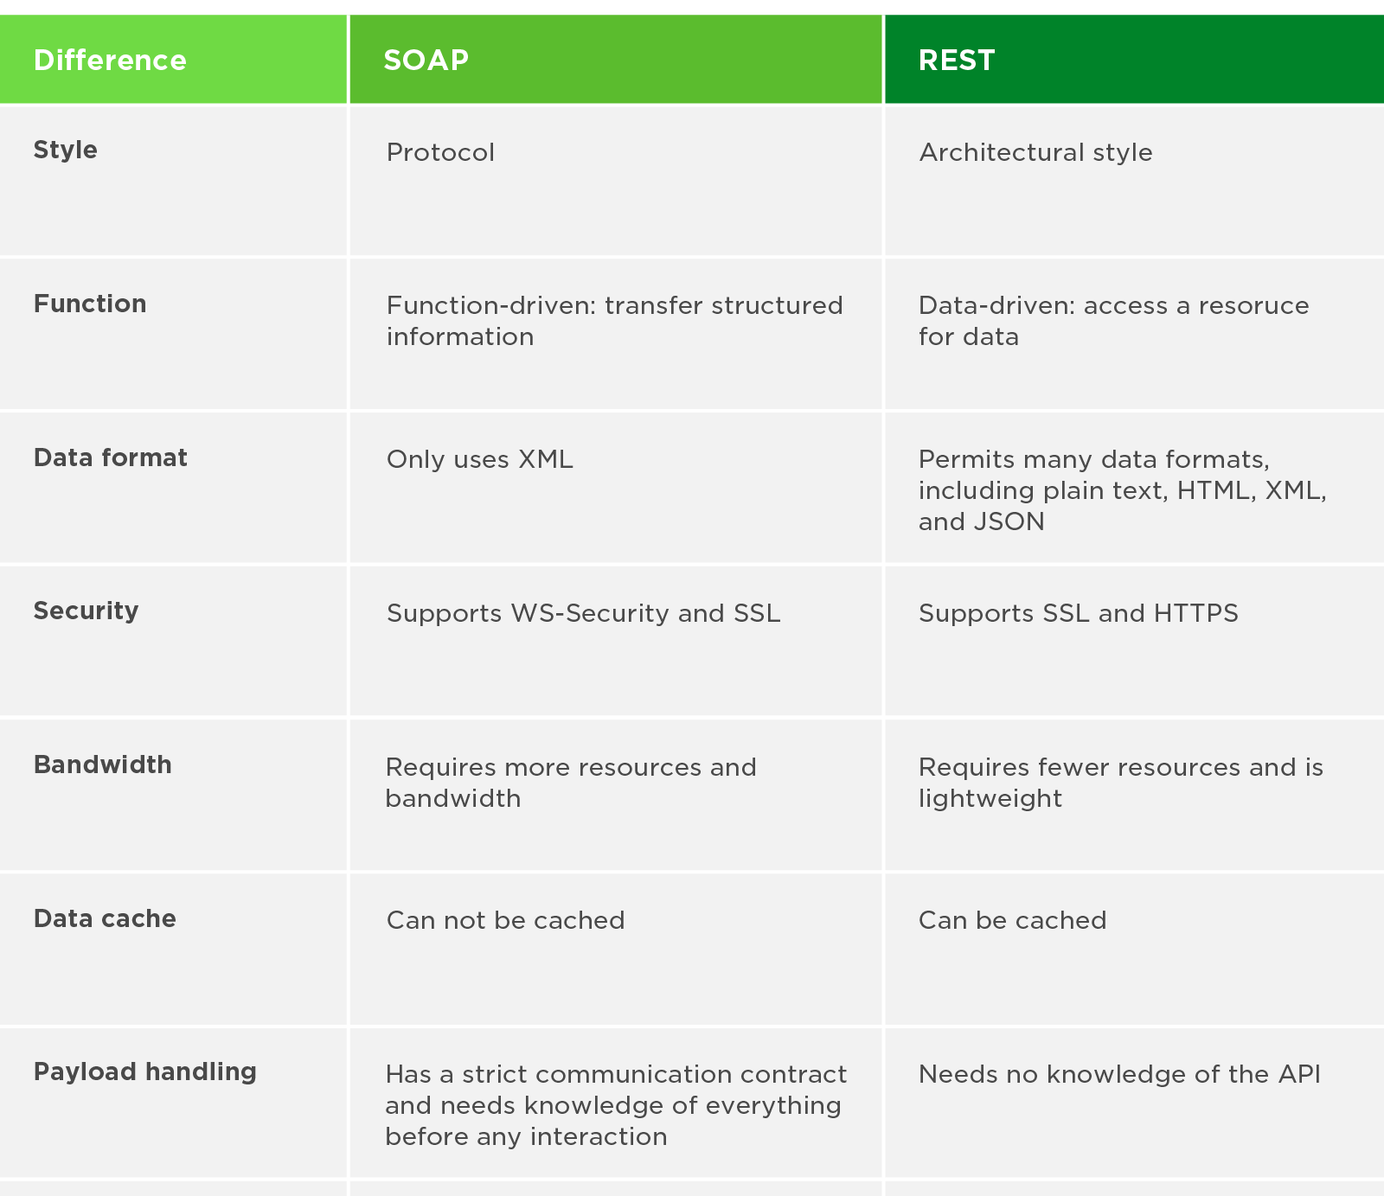
webservices

Slide 6

Rest webservices
REST - Representational State Transfer:
the architecture of transferring the state of resources, for designing distributed systems
a set of rules/standards/guidelines for how to build a web API
when application A communicates with application B, application A supplies a representation of its relevant state with each request to application B

Slide 7
Rest webservices
REST design principles:
Client-Server: concerns should be separated between clients and servers. This enables client and server components to evolve independently and in turn allows the system to scale.
Stateless: the server shouldn’t remember the state of the client. Instead, clients must include all the necessary information in the request.
Layered System: multiple layers such as gateways, firewalls, and proxies can exist between client and server. Layers can be added, modified, reordered, or removed transparently to improve scalability.
Cache: the client can cache responses and reuse them for later requests. This reduces the load on the server and helps improve the performance.
Uniform Interface: interfaces uniformity. The components can evolve independently if they implement the agreed-on contract.

Slide 8
Rest apis
a Web API conforming to the REST architectural style is a REST API
having a REST API makes a web service “RESTful”
REST doesn’t dictate the actual technology to be used for developing APIs
Uniform Interface in a REST application is achieved through these abstractions:
resources
representations
URIs
HTTP methods

Slide 9
Resources
a resource is anything that can be accessed or manipulated.
resources must have an identifier – the URI (Uniform Resource Identifier)
the URI represents the actual location of a resource on the Web
URI templates provide a standardized mechanism for describing URI structure (http://blog.example.com/{year}/posts, where year is a variable)

Slide 10
representations
Serialized data of a resource is a representation. It can be viewed as a snapshot of a resource’s state at a given point in time
REST components interact with a resource by transferring its representations back and forth. They never directly interact with the resource
one resource can have several representations, such as HTML, XML, JSON, PDFs, JPEGs, MP4s etc
JSON is the de facto standard for REST services

Slide 11
HTTp request methods
CRUD: four basic persistence functions - Create, Read, Update, and Delete
combination of an URI and a HTTP method generates a CRUD operation for a resource

Slide 12
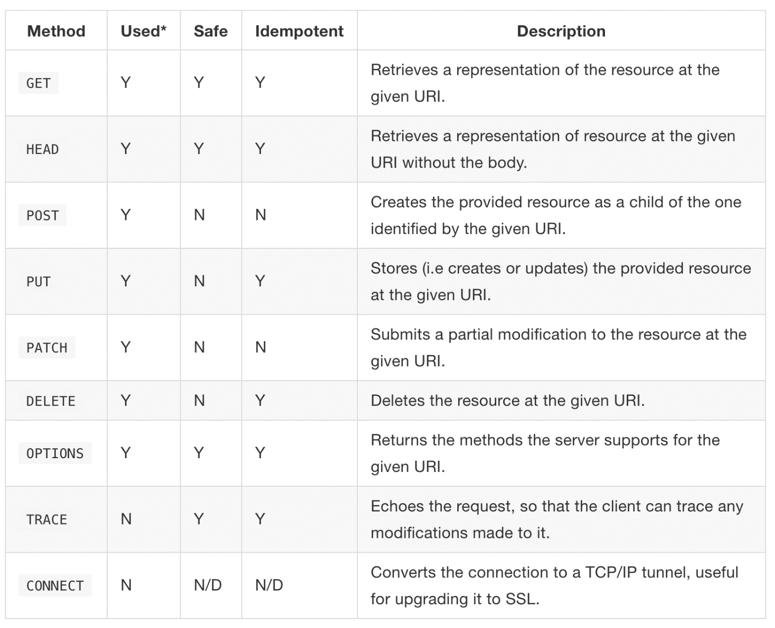
HTTp request methods

Slide 13
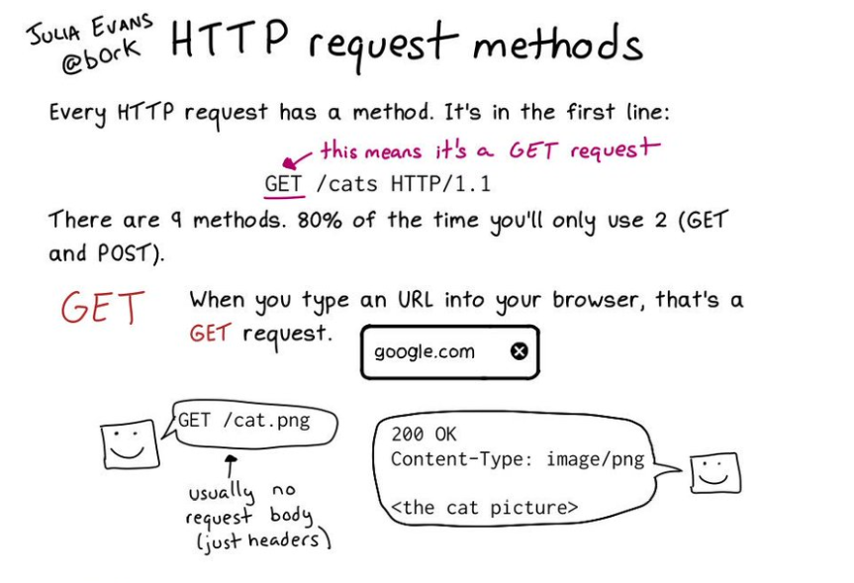
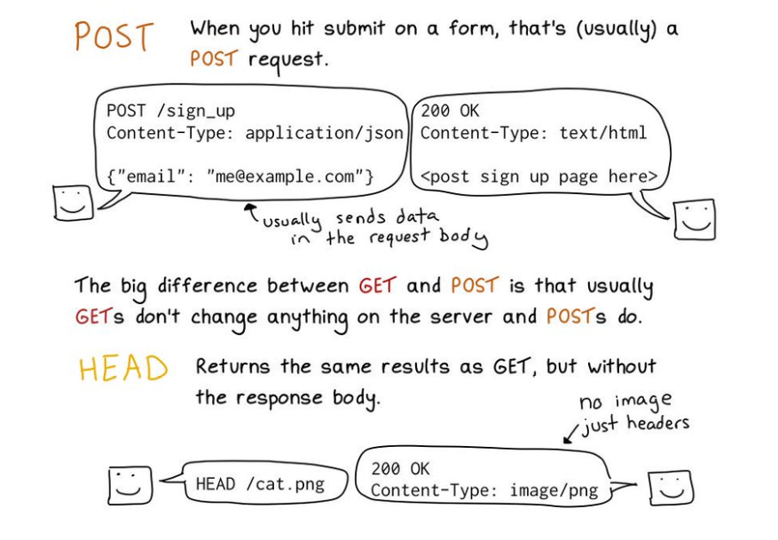
HTTP request methods

Slide 14
http response STATUS codes
the status codes are grouped into the following categories:
Informational Codes: the server has received the request but hasn’t completed processing it – 100 series.
Success Codes: the request has been successfully received and processed – 200 series.
Redirection Codes: the request has been processed, but the client must perform an additional action to complete the request – 300 series.
Client Error Codes: there was an error or a problem with client’s request – 400 series.
Server Error Codes: there was an error on the server while processing the client’s request – 500 series.

Slide 15
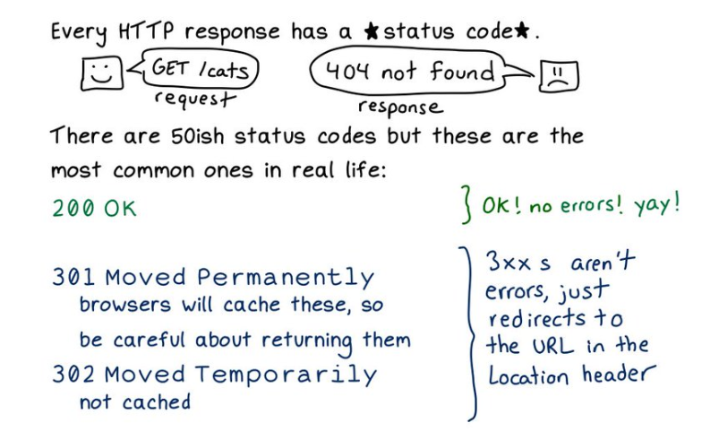
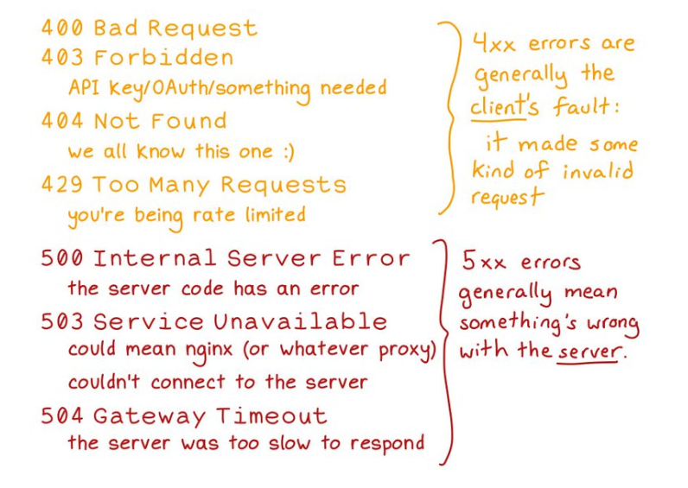
HTTP RESPONSE status codes

Slide 16
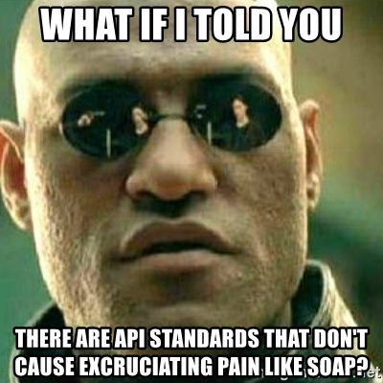
Rest api design
the end users should consume the API easily
high level steps:
identify resources
identify endpoints: design URIs that map resources to endpoints
identify actions: identify the right HTTP methods
identify responses: identify the supported resource representation for the request and response along with the right status codes to be returned

Slide 17
Rest api design
Best practices to model URIs in REST
URI should be simple, intuitive, easy to read, and consistent.
avoid having your API start the root domain (http://example.com/api instead of http://api.example.com)
resource endpoints should be a plural and not a singular name (http://example.com/api/products)
access a specific resource by its identifier in HTTP GET call (http://example.com/api/products/prod123)
do not use privileged user information as unencrypted parameters (http://example.com/api/user?password=039456337-87)
allow multiple results representations:
http://example.com/api/products?format=json
http://example.com/api/products?format=pdf

Slide 18
bibliography
Spring in Action, by Craig Walls
Spring REST, by Balaji Varanasi, Sudha Belida
REST API Design Rulebook, by Mark Masse
https://www.ics.uci.edu/~fielding/pubs/dissertation/top.htm

Slide 19

Q&A

Slide 20
THANK YOU
DANIELA spilcĂ

